Slide 1
TRACK AND TRACE SUPPLY CHAIN
PIP2001 Capstone Project
Review-1
Batch Number:
29
20211CSE0148 | K V BRAMHANANDA REDDY
20211CSE0093 | THOTA YASWANTH RAM
20211CSE0097 | KUMMARA CHARAN SAI
20211CSE0121 | D GURUVARDHAN REDDY
Under the Supervision of,
Ms. Ayesha Taranum
Assistant Professor
School of Computer Science and Engineering
Presidency University
Roll Number | Student Name
Name of the Program: Computer Science and Engineering(CSE)
Name of the HoD: Dr. Asif Mohammed
Name of the Program Project Coordinator: Mr. Amarnath J L
Name of the School Project Coordinators: Dr. Sampath A K / Dr. Abdul Khadar A / Mr. Md Ziaur Rahman

Slide 2
Introduction
Track and trace in the supply chain is a comprehensive system designed to monitor and record the movement of products through every step of the supply chain. This process begins at the origin of raw materials, continues through manufacturing and distribution, and ends when the product reaches the final consumer. It ensures that every stage is logged and traceable, allowing for complete transparency and control.
The primary goal of track and trace systems is to enhance visibility into the supply chain, ensuring that businesses can respond swiftly to issues such as product recalls, delays, and inventory shortages
Common technologies include RFID (Radio Frequency Identification), GPS (Global Positioning System), and blockchain, which enhance data accuracy and security.
These systems help businesses improve logistics efficiency, reduce operational costs, and respond quickly to any disruptions or delays.

Slide 3
Literature Review
Sl.no. | Paper Title | Authors | Proposed Model | Results | Drawbacks | Year
1 | Blockchain-based Track and Trace System for Supply Chain Management | Lee J., Kim S. | A blockchain-enabled system to track goods at every point in the supply chain with immutable record keeping. | Improved traceability, reduced fraud, and enhanced transparency across supply chains. | High implementation costs and energy consumption associated with blockchain technologies. | 2020
2 | IoT-Enhanced Track and Trace System for Perishable Goods | Zhang L., Chen W. | IoT sensors integrated into a supply chain system for real-time tracking of perishable goods, enabling condition monitoring. | Increased efficiency in tracking goods with real-time alerts on temperature changes. | Scalability issues with handling large volumes of sensor data in global operations. | 2020
3 | Distributed Ledger Technologies for Secure Supply Chain Traceability | Davis P., Nguyen T. | A distributed ledger system using smart contracts to automate the verification of goods and transactions at each stage. | Improved security and efficiency with tamper-proof records and automated contract executions. | Legal challenges and jurisdictional issues in cross-border transactions. | 2021
4 | Artificial Intelligence and Blockchain in Supply Chain Traceability | Patel A., Johnson R. | Combination of AI and blockchain for predictive analytics and real-time tracking of goods in complex supply networks. | Improved decision-making and risk assessment with real-time data insights. | Complexity in integrating AI and blockchain systems; high costs for deployment. | 2021
5 | Enhancing Supply Chain Transparency with Digital Twins | Wong T., Liu M. | Utilizes digital twin technology to create virtual models of supply chain processes for enhanced visibility and traceability. | Real-time simulation and prediction of supply chain disruptions, improving response times. | Requires substantial data infrastructure investment and expertise to manage digital twin models. | 2020

Slide 4
Literature Review
Sl.no | Paper Title | Authors | Proposed Model | Results | Drawbacks | Year
6 | Blockchain and RFID for End-to-End Supply Chain Traceability | Smith K., Garcia L. | Integration of blockchain with RFID tags for tracking goods from origin to delivery. | Improved accuracy in tracking and inventory management. | High costs associated with RFID hardware and blockchain integration. | 2021
7 | Secure and Transparent Food Supply Chain Using Blockchain and IoT | Khan H., Ahmed R. | A blockchain-IoT hybrid system for tracking food products, ensuring quality and origin through real-time monitoring. | Enhanced food safety, reduced fraud, and compliance with regulations. | Data privacy concerns and technical challenges with IoT sensor integration. | 2022
8 | Leveraging Machine Learning for Predictive Traceability in Supply Chains | Kumar P., Rao S. | Machine learning models integrated into traceability systems to predict supply chain risks and optimize processes. | Improved efficiency through predictive analytics and early risk detection. | High computational costs and potential accuracy issues in diverse supply chains. | 2022
9 | Privacy-Preserving Track and Trace System for Pharmaceutical Supply Chains | Liu J., Evans M. | Uses homomorphic encryption and blockchain to ensure privacy while tracking pharmaceutical products across the supply chain. | Strengthened data security and privacy, reduced counterfeiting risks. | High computational overhead and complexity in encryption management. | 2023
10 | Cloud-Based Track and Trace Systems for Global Supply Chains | Wang R., Tan J. | A cloud-based platform providing real-time access to supply chain data for all stakeholders. | Increased collaboration and data sharing across global networks. | Potential security vulnerabilities and data breaches in centralized cloud systems. | 2023

Slide 5
Literature Review
Sl.no. | Paper Title | Authors | Proposed Model | Results | Drawbacks | Year
11 | Blockchain-Enabled Traceability for Sustainable Supply Chains | Silva L., Martinez J. | Blockchain implementation to ensure traceability and transparency of sustainable and ethical sourcing in supply chains. | Improved compliance with sustainability standards and consumer trust. | High cost of adoption and integration with existing legacy systems. | 2020
12 | IoT and Big Data in Supply Chain Traceability for Manufacturing | Gonzalez F., Lee K. | Big data analytics combined with IoT devices for enhanced visibility of materials and products throughout manufacturing supply chains. | Increased accuracy in demand forecasting and improved operational efficiency. | Challenges with data integration and real-time analytics. | 2021
13 | Smart Contracts for Supply Chain Track and Trace Using Blockchain | Turner A., Williams M. | Smart contracts to automate compliance and verification at each stage of the supply chain. | Reduced human errors and faster transaction verification. | Legal uncertainties and lack of standardized smart contract frameworks. | 2020
14 | Blockchain and AI for Cold Chain Logistics | Gupta N., Zhao H. | Combining AI algorithms with blockchain for real-time monitoring and anomaly detection in cold chain logistics. | Improved safety and reduced spoilage of temperature-sensitive products. | High data processing costs and technical challenges in sensor deployment. | 2021
15 | Real-Time Supply Chain Monitoring Using IoT and Edge Computing | Kumar S., Brown D. | IoT sensors integrated with edge computing to process and analyze supply chain data closer to the source. | Reduced latency and real-time decision-making capabilities. | Limited scalability and high initial infrastructure costs. | 2022

Slide 6
Literature Review
Sl.no. | Paper Title | Authors | Proposed Model | Results | Drawbacks | Year
16 | Blockchain for Traceability in Automotive Supply Chains | Santos P., Young J. | A blockchain-based traceability system to monitor the provenance and lifecycle of automotive parts across the supply chain. | Enhanced product quality control and recall efficiency. | Issues with supplier adoption and data standardization across the automotive industry. | 2021
17 | Digital Ledger Technology for Transparency in Pharmaceutical Supply Chains | Novak I., Patel S. | Digital ledger technology to track the origin and authenticity of pharmaceutical products, ensuring compliance with safety regulations. | Reduced counterfeit drugs and improved regulatory compliance. | High initial setup costs and resistance from smaller supply chain players. | 2022
18 | RFID-Based Traceability Systems for Food Supply Chains | Garcia A., Smith R. | RFID-enabled traceability for tracking food products from farm to table. | Improved food safety, reduced wastage, and faster recall processes. | Costly RFID tags and challenges in handling large-scale implementations. | 2021
19 | AI-Powered Predictive Maintenance in Supply Chain Logistics | Wei F., Carter J. | AI-powered predictive analytics used to monitor and maintain supply chain logistics equipment. | Increased equipment uptime and reduced maintenance costs. | Requires significant data collection and model training for accuracy. | 2022
20 | Blockchain-Integrated IoT for Sustainable Seafood Supply Chain | Rivera S., Han D. | Blockchain and IoT used to track and verify the sustainability of seafood products from ocean to consumer. | Improved sustainability certifications and reduced illegal fishing practices. | Technical difficulties in integrating remote IoT devices in ocean environments. | 2023

Slide 7
Existing method Drawback
Despite the advancements in track and trace technologies, several limitations and challenges are associated with the current methods. These drawbacks hinder the efficiency and reliability of supply chain operations.
Lack of Real-Time Data:Many traditional track and trace systems rely on manual data entry or batch processing, leading to delays in data updates. Real-time visibility is often limited, resulting in slow responses to disruptions, delays, or unexpected changes in the supply chain.
Data Inconsistency and Integration Issues :Different stakeholders in the supply chain use various tracking systems and data formats, leading to inconsistencies . Integrating data from disparate systems (such as RFID, GPS, and ERP software) remains a significant challenge, affecting the accuracy of tracking and traceability.
Security and Privacy Concerns : Data security is a major issue, as sensitive information regarding product origins, movement, and delivery details can be vulnerable to cyberattacks . Unauthorized access or data breaches can lead to significant financial losses, legal issues, and damage to brand reputation.
Dependence on Human Intervention : Traditional methods often require manual data entry and monitoring, increasing the chances of human error . Manual processes are time-consuming and prone to inaccuracies, which can compromise the efficiency of the entire supply chain.

Slide 8
Proposed Method
Machine Learning for Predictive Analytics: Use machine learning algorithms to predict supply chain disruptions and optimize inventory levels.
Benefits: Enables proactive decision-making and enhances resilience.
Consumer Engagement Tools: Develop mobile apps or web interfaces that allow consumers to access product traceability information.
Benefits: Increases consumer trust and engagement by providing transparency about product origins and journeys.
Stakeholder Collaboration Platforms: Develop collaborative platforms for stakeholders (suppliers, manufacturers, logistics providers) to share information and coordinate activities.
Benefits: Improves communication and collaboration, leading to a more responsive supply chain.
Sustainability Tracking: Incorporate methods to track and report on sustainability practices within the supply chain.
Benefits: Helps organizations meet regulatory requirements and consumer demand for sustainable practices.

Slide 9
Objectives
The primary objectives of implementing a track and trace system in the supply chain are to enhance transparency, improve efficiency, and ensure that products move seamlessly from origin to destination while maintaining high standards of quality and safety.
Enhance Transparency : Provide visibility into the movement of goods throughout the supply chain. Enable all stakeholders to track the journey of products from origin to end consumer.
Improve Product Safety : Monitor products for quality and safety at each stage of the supply chain. Quickly identify and address issues related to recalls or contamination.
Increase Efficiency: Streamline processes by minimizing delays and reducing errors in inventory management Optimize logistics and resource allocation through real-time data access.
Ensure Compliance : Meet regulatory requirements by maintaining accurate records of product history. Facilitate audits and inspections with readily available traceability data.
Enable Quick Response to Issues: Rapidly trace affected products in case of recalls or safety alerts. Enhance crisis management capabilities by having detailed tracking information.

Slide 10
Methodology/Modules
Identification and Data Capture: Barcode/RFID Technology Utilize barcodes or RFID tags for unique product identification. Data Entry Systems Implement systems for capturing product information at various stages, including production, packaging, and shipping.
Data Integration: Centralized Database Establish a centralized system to aggregate data from various sources (manufacturers, suppliers, distributors). Interoperability Ensure that different systems (ERP, WMS) can communicate and share data seamlessly.
Tracking Mechanisms: Real-Time Tracking Use GPS and IoT devices to monitor the location and condition of products in transit. Timestamping Record time and location data at each stage of the supply chain to create a chronological product history.
Data Analysis and Visualization: Data Analytics Tools Implement analytical tools to process and analyze traceability data for insights. Dashboards Create visual dashboards to provide stakeholders with real-time access to supply chain information.
Verification and Validation: Quality Control Checks Conduct regular inspections and audits to verify product authenticity and quality. Blockchain Technology Explore the use of blockchain for immutable record-keeping and verification.

Slide 11
Methodology/Modules
Communication and Reporting: Stakeholder Notifications Implement systems for notifying stakeholders of any issues or updates related to product status. Reporting Tools Generate reports on traceability metrics, compliance, and performance.
Continuous Improvement: Feedback Mechanisms Gather feedback from stakeholders to identify areas for improvement. Adaptation Regularly update processes and technologies based on performance analysis and stakeholder input.
Regulatory Compliance: Documentation Maintain detailed records to ensure compliance with industry regulations and standards. Audit Trails Create audit trails that facilitate regulatory audits and inspections.

Slide 12
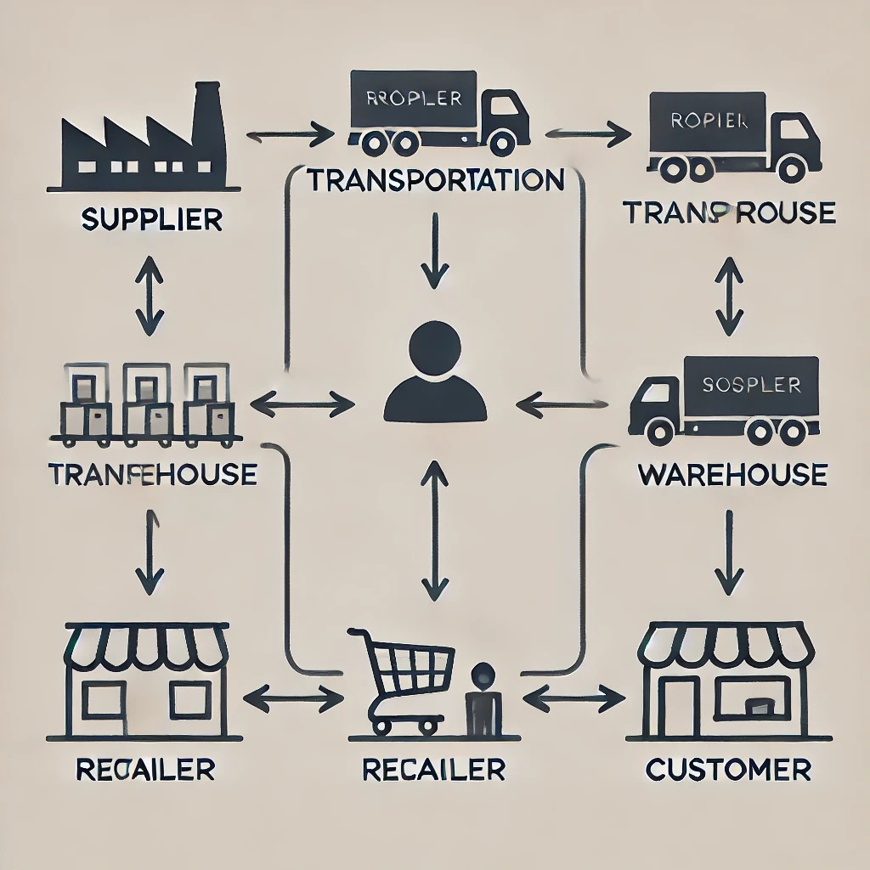
Architecture

Slide 13
software components
Google Cloud
Power BI
Oracle
Blockchain Platforms
Cloud Services
Product Lifecycle Management (PLM) Software

Slide 14
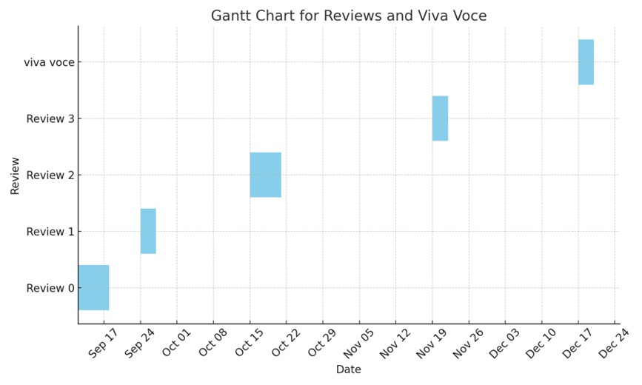
Timeline of Project

Slide 15
Expected Outcomes
Enhanced Product Quality and Safety
Enhanced Customer Trust and Satisfaction
Enhanced Visibility and Transparency
Improved Quality Control and Compliance
Increased Efficiency and Reduced Costs
Risk Management and Fraud Prevention
Sustainability and Ethical Sourcing
Data-Driven Decision Making
Reduced Environmental Impact
Market Positioning
Adoption of New Technologies

Slide 16
Conclusion
In conclusion, implementing a trace and trace supply chain system is a transformative approach that enhances visibility, transparency, and control across the entire supply chain network. By adopting these practices, businesses can:
Ensure Product Quality and Safety
Boost Efficiency and Reduce Costs
Build Trust and Reputation
Promote Sustainability
Leverage Data-Driven Insights

Slide 17
Github Link
Github Link
https://github.com/Bramha2982/trackandtracesupplychain

Slide 18
References
Blockchain Technology for Global Supply Chain Management (2024)
Authors: Julie K. Dunston , Garth V. Crosby
Link: https://ieeexplore.ieee.org/abstract/document/10529266
Digitalization of the healthcare supply chain: a roadmap to generate benefits and effectively support healthcare delivery (2021)
Authors: M. Beaulieu, O. Bentahar
Link: https://www.sciencedirect.com/science/article/pii/S0040162521001499?via%3Dihub
Apple AirTag: a brilliant car tracker, as this road test proves (2021)
Authors: Barry Collins
Link: https://www.forbes.com/sites/barrycollins/2021/05/15/apple-airtag-a-brilliant-car-tracker-as-
Impact of artificial intelligence-driven big data analytics culture on agility and resilience in humanitarian supply chain (2022)
Authors: R. Dubey, D.J. Bryde, Y.K. Dwivedi
Link: https://www.sciencedirect.com/science/article/pii/S0925527322002018
The performance effects of big data analytics and supply chain ambidexterity: the moderating effect of environmental dynamism (2020)
Authors: S. Fosso Wamba,R. Dubey
Link: https://www.sciencedirect.com/science/article/abs/pii/S0925527319303184

Slide 19
References
Strategies to overcome barriers to innovative digitalisation technologies for supply chain logistics resilience during pandemic (2022)
Authors: H. Gupta, A.K. Yadav
Link: https://www.sciencedirect.com/science/article/abs/pii/S0160791X22001117
Real-time supply chain—A blockchain architecture for project deliveries (2020)
Authors: Petri Helo, A.H.M. Shamsuzzoha
link: https://www.sciencedirect.com/science/article/abs/pii/S0736584518306665
Impact of COVID-19 food supply chain: Comparing the use of IoT in three South African supermarkets (2022)
Authors: Linda Njomane, Arnesh Telukdarie
link: https://www.sciencedirect.com/science/article/pii/S0160791X22001920
Assessing sustainability performance of global supply chains: An input-output modeling approach (2020)
Authors: H. Wang, Chen Pan
link: https://www.sciencedirect.com/science/article/abs/pii/S0377221720300941
Effects of supply chain competition on firms’ product sustainability strategy (2020)
Author: Lipan Feng, Weisheng Deng
link: https://www.sciencedirect.com/science/article/abs/pii/S0959652620341068

Slide 20
References
Applying blockchain technology to improve agri-food traceability: A review of development methods, benefits and challenges (2020)
Authors: Huanhuan Feng, Yanqing Duan
link: https://www.sciencedirect.com/science/article/abs/pii/S0959652620310787
Permissioned Blockchain-Based Double-Layer Framework for Product Traceability System (2020)
Authors: Qingyang Ding, Sheng Gao
link: https://ieeexplore.ieee.org/abstract/document/8943216
The Quality Control System of Green Composite Wind Turbine Blade Supply Chain Based on Blockchain Technology (2021)
Authors: Senlai Zhu, Jie Yang
link: https://mdpi.com/2071-1050/13/15/8331
Guest editorial: Supply chain transparency: opportunities, challenges and risks (2024)
Authors: Lujie Chen,Stefan Seuring
link: https://www.emerald.com/insight/content/doi/10.1108/IJOPM-09-2024-992/full/html#sec001
Digitally-enabled sustainable supply chains in the 21st century: A review and a research agenda (2020)
Authors: Maciel M. Queiroz, Éderson Luiz Piato
link: https://www.sciencedirect.com/science/article/abs/pii/S0048969720316909

Slide 21
References
Blockchain and Related Technologies to Support Manufacturing Supply Chain Traceability (2022)
Authors: Michael Pease, Steve Granata
link: https://csrc.nist.gov/pubs/ir/8419/final
The role of IoT in boosting supply chain transparency and efficiency (2024)
Authors: Prisca Amajuoyi, Kudirat Bukola Adeusi
link: https://yyf.tgdaddy.com/4xj4748_9nqeutquamlrqhluzxfmse/8jiiqsmeohk/5prvjygg/5prjuswj/7hzhjsnqwp/
5preuxwj/MSARR-2024-0081.pdf
The Role of Blockchain Technology in Promoting Traceability Systems in Agri-Food Production and Supply Chains (2023)
Authors: Techane Bosona, Girma Gebresenbet
link: https://www.mdpi.com/1424-8220/23/11/5342
A Review and Classification Framework of Traceability Approaches for Identifying Product Supply Chain Counterfeiting (2022)
Authors: Sotiris P. Gayialis, Dimitrios Masouras
link: https://www.mdpi.com/2071-1050/14/11/6666
Global Value Chains’ Disaggregation through Supply Chain Collaboration, Market Turbulence, and Performance Outcomes (2021)
Authors: Amit Arora, Anshu Arora
link: https://www.mdpi.com/2071-1050/13/8/4151

Slide 22
Project work mapping with SDG
The key SDGs often related to supply chains are:
SDG 12: Responsible Consumption and Production Track and trace systems help reduce waste, ensure efficient resource use, and promote transparency.
SDG 9: Industry, Innovation, and Infrastructure These systems drive technological advancements and promote modern infrastructure in supply chains .
SDG 13: Climate Action By optimizing transportation and production processes, track and trace systems can reduce carbon footprints . SDG 8: Decent Work and Economic Growth Enhancing supply chain visibility improves efficiency, creates fairer working conditions, and supports economic growth .
SDG 17: Partnerships for the Goals Track and trace fosters cooperation among suppliers, manufacturers, retailers, and regulators to achieve sustainability goals
Simple SDG Diagram for Track and Trace Supply Chain: Center: Track and Trace Supply Chain .
Surrounding SDGs : SDG 12 (Responsible Consumption & Production)
SDG 9 (Industry, Innovation & Infrastructure)
SDG 13 (Climate Action)
SDG 8 (Decent Work & Economic Growth)
SDG 17 (Partnerships for the Goals)

Slide 23
Thank You

